Slide 1

SRM INSTITUTE OF SCIENCE AND TECHNOLOGY Chennai – 600 089 SCHOOL OF COMPUTER SCIENCE ENGINEERING DEPARTMENT OF COMPUTER SCIENCE AND ENGINEERING
18CSP109L - PROJECT
LLM BASED MULTILINGUAL COMMENTARY GENERATOR
FINAL VIVA VOCE 2025
CLASS/YEAR/SEC : CSE/IV/I BATCH NUMBER :9
Team Members | Supervisor
PRAVEEN RAM R – RA2111003020475 ANKITHA S – RA2111003020476 SHAIK MOHAMMED GHOUSE – RA2111003020632 | Dr. B. Deepa, AP/CSE

Slide 2
AGENDA
Abstract
Scope and Motivation
Introduction
Literature Survey ( Table)
Objective
Problem Statement
Proposed Work
Architecture Diagram/Flow Diagram/Block Diagram
Novel idea
Modules
Module Description
Algorithm
Software & Hardware Requirements
Implementation
Results and Discussion
Conclusion
Future Work
References (Min. 15 references)
Outcome ( Paper Submitted Proof /Patent Filing Proof)

Slide 3
ABSTRACT
Real-time commentary on cricket matches is a challenging task that requires precise and coherent descriptions of events as they unfold. Traditional methods often fall short in providing timely and accurate insights into the game. This study aims to explore the utilisation of innovative Large Language Model (LLM) techniques to develop an adept language model – dubbed LLM-Commentator – that can generate real-time commentary on cricket matches. The goal is to demonstrate that open-source language models, when fine-tuned with domain-specific data on consumer-grade hardware, can accurately depict cricket events from raw match data. Three distinct training strategies are employed to fine-tune the language models, addressing various challenges encountered in generating real-time cricket commentary. The study evaluates the efficacy of these models in producing coherent and accurate descriptions of unseen cricket events. Among the three strategies proposed, the Mixed Immediately Model emerges as particularly efficient in learning and adeptly handling challenging workloads. This suggests a promising future for simultaneous multi-task learning with compact, open-source language models in the context of real-time sports commentary. Additionally, the study highlights the practicality of utilising consumer-grade hardware for fine-tuning language models with specialised knowledge. The findings underscore the importance of customising training approaches and ensuring well-balanced datasets when fine-tuning language models for specific tasks. Moreover, they serve as a practical guide for broader accessibility to large language models and significantly contribute to the application of NLP in sports journalism, enabling more insightful and engaging real-time commentary on cricket matches.

Slide 4
SCOPE
The study focuses on developing an AI-based system capable of generating real-time cricket commentary using large language models (LLMs).
The proposed solution emphasizes the feasibility of training and running advanced models on affordable, consumer-grade GPUs.
The system aims to democratize access to LLMs, enabling smaller organizations, researchers, and enthusiasts to create automated commentary tools without high-end computational resources.
The model specializes in cricket, covering granular match events such as goals, fouls, and substitutions with natural language descriptions.
By leveraging open-source models like Open LLaMA, the approach offers tailored solutions for specific use cases in sports journalism and fan engagement.
The system incorporates match data and commentary, providing structured insights and enhancing match analysis.
The model is designed to handle a variety of match scenarios, ensuring comprehensive coverage of cricket matches.
The techniques and methodologies can be extended to other sports or domains requiring real-time commentary and insights.
Practical uses include live match commentary, fan engagement through digital platforms, and bridging the gap between traditional and modern sports consumption.

Slide 5
MOTIVATION
Many small and domestic cricket leagues lack the financial resources to provide live commentary or engage fans effectively, creating a need for cost-effective solutions.
The rise of digital platforms in cricket consumption has increased demand for consistent, engaging content, which this AI-driven commentary system aims to fulfil.
By making AI-based cricket commentary generation accessible on consumer-grade hardware, the solution empowers smaller leagues, tournaments, and clubs to thrive in the digital-first landscape.
The system enhances the viewing experience for cricket fans by delivering accurate, coherent, and engaging ball-by-ball commentary tailored to match events.
Traditional commentary systems often struggle to dynamically adapt to the complex and evolving nature of cricket matches, especially in domestic or amateur settings.
This project explores state-of-the-art LLM fine-tuning techniques to innovate real-time cricket commentary generation, pushing the boundaries of AI applications in sports technology.
Automated commentary can streamline content creation, reduce dependency on human resources, and enhance coverage quality for cricket media outlets.
By showcasing the potential of AI-driven cricket commentary using low-cost solutions, the system contributes to the broader democratization of NLP technologies.
Through multilingual and culturally relevant cricket commentary, the system can engage audiences in diverse cricket-loving regions, expanding the sport’s reach to grassroots and international levels.

Slide 6
INTRODUCTION
Multilingual commentary generation is an emerging domain within the broader field of Natural Language Processing (NLP), powered by advancements in Large Language Models (LLMs). This project focuses on developing a scalable system capable of generating context-aware, fluent, and dynamic commentary in multiple languages.
The application of such a system spans domains such as sports broadcasting, live event coverage, education, and entertainment, where real-time and culturally nuanced communication is critical. The rapid evolution of LLMs, has unlocked new possibilities for multilingual NLP tasks.
These models can process and generate text with impressive fluency across languages, but challenges persist, including limited low-resource language support, contextual inconsistencies, and high computational costs. Addressing these limitations can revolutionize commentary generation by creating systems that are accessible, real-time, and culturally adaptive.
By leveraging advanced architectures, multilingual datasets, and efficient fine-tuning techniques, this project aims to push the boundaries of multilingual NLP. Its success could set a precedent for innovative applications across industries, enhancing human-machine interaction in a globalized world.

Slide 7
LITERATURE SURVEY
S.No. | Title of the Paper | Year | Journal/Conference Name | Inferences
1 | LLM-Commentator: Novel fine-tuning strategies of large language models for automatic commentary generation using cricket event data | 2024 | Knowledge Based Systems | Model used in this project is Large Language Model, the merit is the model is very stable and the demerit is it generated only in 1 language.
2 | Generative AI for Sports Commentary Generation | 2023 | International Conference on AI in Sports | Uses GPT-3 with proprietary sports datasets. Merits: dynamic commentary generation. Demerits: poor real-time performance.
3 | Multilingual Text Generation with LLMs: A Case Study | 2023 | Journal of Artificial Intelligence | Implements mT5 with CC100 dataset. Merits: high fluency in diverse languages. Demerits: computationally intensive.
4 | Few-Shot Learning for Multilingual Text Generation | 2022 | ACL Proceedings | Uses GPT-3 with few-shot learning on XNLI. Merits: reduced need for fine-tuning. Demerits: limited context adaptation.
5 | Cross-Lingual Transfer in NLP | 2022 | Transactions of ACL | Leverages XLM-R with OPUS dataset. Merits: robust on low-resource languages. Demerits: slower inference speed.

Slide 8
LITERATURE SURVEY
S.No. | Title of the Paper | Year | Journal/Conference Name | Inferences
6 | Multimodal Approaches to Sports Commentary | 2021 | NeurIPS Workshops | Combines BERT and CNN with multimodal datasets. Merits: improved context understanding. Demerits: complex architecture.
7 | Enhancing Machine Translation with LLMs | 2021 | IEEE Transactions on AI | Uses mBART with Europarl dataset. Merits: better translation quality. Demerits: struggles with idiomatic expressions.
8 | Fine-Tuning LLMs for Multilingual Text Applications | 2020 | EMNLP Proceedings | Adapts T5 with multilingual benchmarks. Merits: high accuracy on downstream tasks. Demerits: requires large computational resources.
9 | Real-Time Text Generation with Pre-Trained Models | 2020 | Journal of Computational Linguistics | Utilizes GPT-2 with OpenSubtitles dataset. Merits: fast generation speed. Demerits: lacks coherence in complex contexts.
10 | BERT and Beyond: A Survey on NLP with Transformers | 2019 | ACM Computing Surveys | Surveys transformer-based models like BERT. Merits: detailed comparative study. Demerits: lacks implementation details.

Slide 9
LITERATURE SURVEY
S.No. | Title of the Paper | Year | Journal/Conference Name | Inferences
11 | Neural Machine Translation for Multilingual Contexts | 2018 | Neural Computing and Applications | Uses seq2seq with WMT datasets. Merits: foundational for multilingual NMT. Demerits: limited scalability.
12 | Zero-Shot Multilingual Text Generation | 2018 | Proceedings of NAACL-HLT | Adopts multilingual seq2seq with TED Talks corpus. Merits: efficient zero-shot learning. Demerits: limited accuracy in non-Western languages.
13 | Multilingual Transfer for Low-Resource Languages | 2017 | ACL Proceedings | Leverages cross-lingual embeddings with Universal Dependencies. Merits: improves low-resource tasks. Demerits: alignment challenges.
14 | Automated Commentary for Sports Video | 2016 | NeurIPS Conference | Uses LSTMs with Sports-1M dataset. Merits: audio-text alignment. Demerits: poor handling of noisy inputs.
15 | Statistical Machine Translation for Commentary Tasks | 2015 | Machine Translation Journal | Adopts phrase-based models with bilingual corpora. Merits: interpretable results. Demerits: struggles with fluency and context.

Slide 10
OBJECTIVES
Build a large language model (LLM)-based system capable of generating accurate, engaging, and near-real-time commentary for cricket matches, covering diverse events like wickets, runs, and partnerships.
Demonstrate the feasibility of fine-tuning LLMs on affordable, consumer-grade GPUs, ensuring accessibility for smaller cricket leagues, independent researchers, and enthusiasts.
Employ advanced fine-tuning techniques like QLoRA to adapt open-source LLMs for cricket-specific commentary tasks, incorporating granular match details.
Optimize the model to produce coherent, contextually accurate descriptions of cricket events, such as sixes, no-balls, wickets, and high-pressure overs.
Explore and evaluate three novel fine-tuning methodologies—Layered Model (LM), Mixed Sequentially Model (MSM), and Mixed Immediately Model (MIM)—to improve performance, learning efficiency, and retention of knowledge.
Enhance the viewing and interactive experience for cricket fans by providing insightful, real-time commentary tailored to match events and scenarios.
Enable smaller cricket leagues, domestic tournaments, and community-level matches to leverage AI-driven commentary for fan engagement and digital presence.
Contribute to broader accessibility of advanced NLP technologies, proving the feasibility of deploying sophisticated AI solutions in resource-constrained environments.
Provide a scalable and adaptable framework for integrating advanced NLP techniques into cricket journalism, paving the way for similar applications in other sports and event-based domains.

Slide 11
PROBLEM STATEMENT
Inadequate Real-Time Performance: Many existing systems fail to generate fluent and accurate commentary in real time due to slow inference speeds, making them unsuitable for dynamic and fast-paced scenarios like live sports or events.
High Computational Demand: Fine-tuning state-of-the-art models like T5 and mT5 requires immense computational resources, making these solutions impractical for real-time or resource-constrained environments
Contextual Inconsistencies: Models like GPT-2 and mT5 exhibit a lack of coherence and contextual understanding when handling complex and real-time commentary, particularly in multilingual scenarios where cultural nuances and idiomatic expressions are critical.

Slide 12
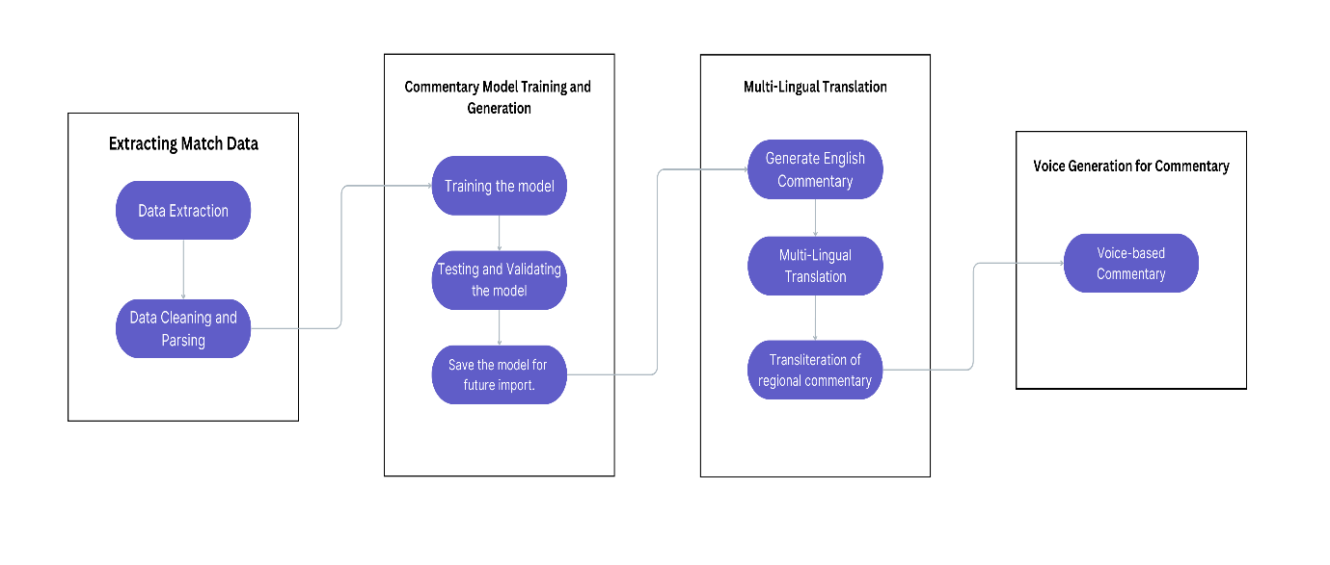
PROPOSED WORK-BLOCK DIAGRAM

Slide 13
PROPOSED-NOVEL IDEA
Utilizes QLoRA and advanced fine-tuning techniques to adapt large language models (LLMs) for cricket commentary, making it feasible to train on affordable GPUs without needing expensive computational resources.
Introduces three methodologies—Layered Model (LM), Mixed Sequentially Model (MSM), and Mixed Immediately Model (MIM)—to efficiently train the model for diverse cricket events such as wickets, runs, partnerships, and overs.
Implements multitask learning strategies to handle simultaneous descriptions of cricket events (e.g., sixes, no-balls, and power plays) while maintaining coherence and relevance in real-time.
Utilizes cricket-specific datasets enriched with granular details like player statistics, match context, ball-by-ball events, and historical data to generate accurate and engaging commentary.
Adopts a complexity scoring system to prioritize training on different cricket events, balancing learning between simple events (dot balls or singles) and complex scenarios (hat-tricks, high-pressure overs).
Leverages transformer architecture and techniques like LoRA to optimize model performance, ensuring efficient fine-tuning tailored to cricket-specific commentary tasks.
Standardizes cricket datasets into a JSONL format, capturing granular event data like bowlers, batsmen, pitch details, and scores, streamlining the training process.
Demonstrates how advanced AI models can be fine-tuned and deployed locally, empowering smaller cricket leagues and enthusiasts to create automated commentary systems.
Provides a scalable template that can be extended to other sports like hockey or esports or applied to domains requiring real-time commentary for sequential events.

Slide 14
PROPOSED-MODULES
The modules used in the project are:
Module 1: Live Data Extraction
Module 2: Commentary Generation
Module 3: Multilingual Commentary Translation and Transliteration

Slide 15
MODULE 1 - Outcome
The modules focuses on querying the live match data.
This data is processed to generate the commentary.
This module uses API to retrieve data from third-party data providers.
Several data pointers are queried in this module, to process and serve for the other modules of the project.

Slide 16
MODULE 2 - Outcome
Utilizes transformer models (GPT) to generate engaging commentary.
Ensures event-specific, player-specific, and game-specific context in generated text.
Varies tone and style to enhance user engagement.
Implements algorithms to reduce redundant and biased statements.
Adjusts commentary tone based on the intensity of the event.

Slide 17
MODULE 3 - Outcome
Supports multiple languages for diverse audience engagement.
Uses best translation models for high-quality translations.
Converts names and terms accurately into different scripts for phonetic consistency.
Adapts phrasing, idioms, and expressions to fit linguistic nuances.
Enables audio-based multilingual commentary for broadcasting applications.

Slide 18
SOFTWARE & HARDWARE REQUIREMENTS
Hardware Requirement:
Laptop
8 GB Ram
Solid State Drive (SSD)
Software Requirement:
Visual Studio Code & Libraries
JSON Dataset

Slide 19
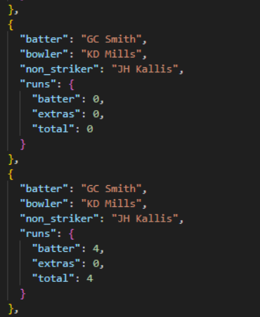
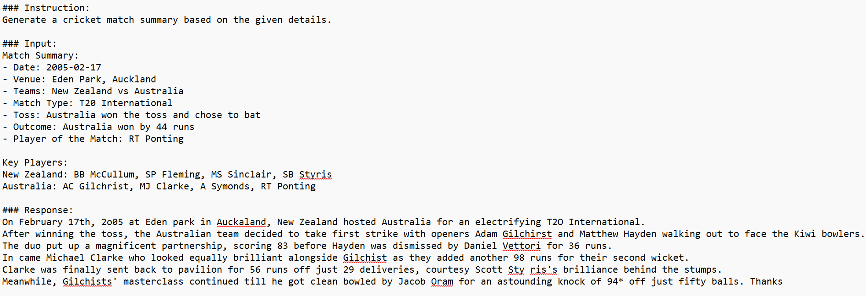
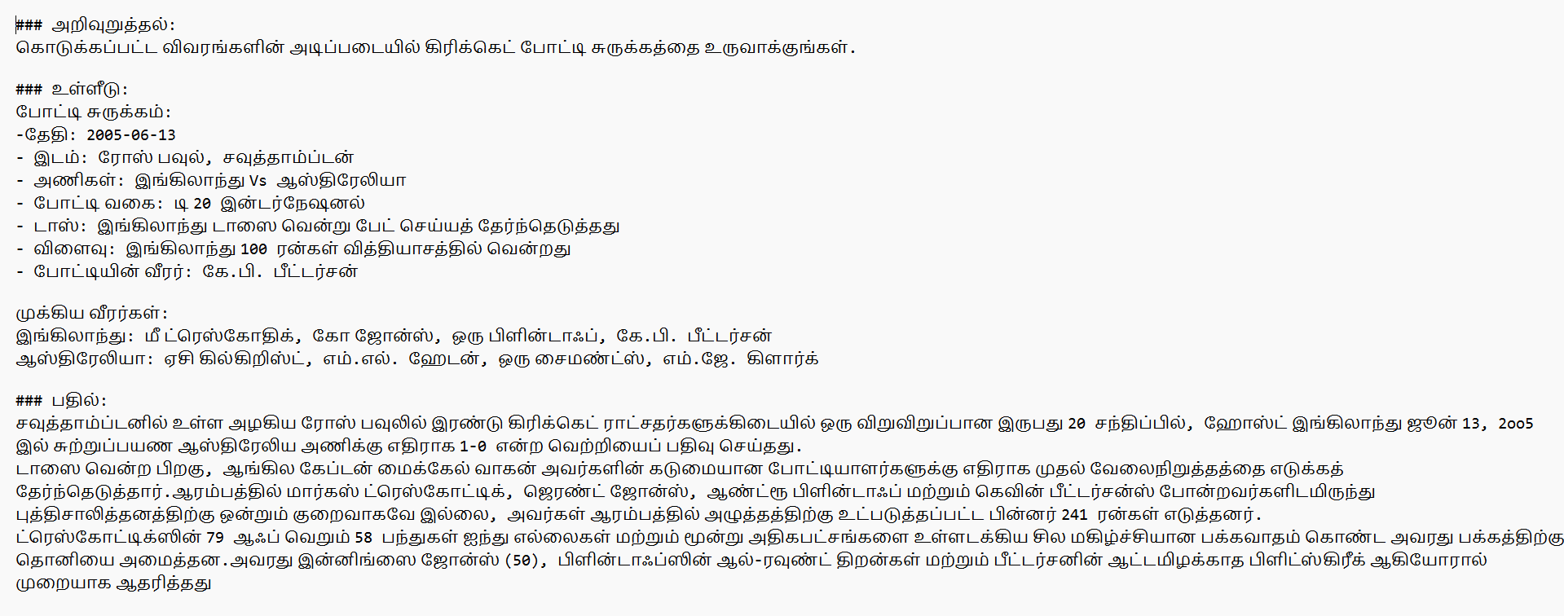
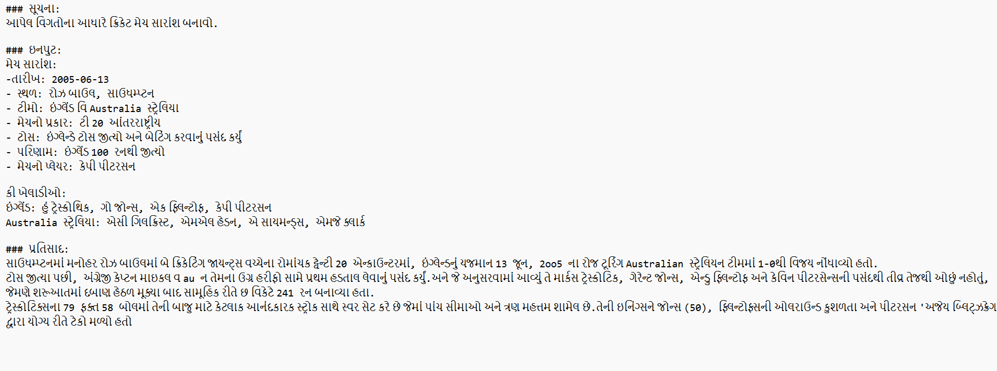
MODULE OUTPUT

Slide 20
RESULTS AND DISCUSSIONS
Parameter | LLM-Commentator (Ours) | cricket LLM [10] | SkyEyeGPT [11] | Meet2Mitigate [21]
Accuracy | High (Fine-tuned, 6 styles) | Moderate (domain-specific) | Moderate (specialized domain) | Moderate (construction-specific)
Inference Speed | Fast (Real-time capable) | Fast (Real-time capable) | Slow (No real-time) | Moderate (Real-time capable)
Model Size | Small to Moderate (Low-resource, TTS) | Large (no low-resource) | Large (Remote Sensing) | Large (Construction domain)
Training Convergence | Moderate to Fast (optimized, expressive) | Moderate (domain-focused) | Slow (complex data, remote sensing) | Moderate to Slow (engineering data)

Slide 21
CONCLUSION
This project successfully demonstrates a comprehensive system for generating multilingual voice-based sports commentary using a large language model (LLM). Beginning with structured match data in JSON format, the system efficiently processes and parses the data to generate coherent English commentary. It then translates the commentary into multiple regional languages and converts the text into speech. The integration of data extraction, model training, translation, and voice generation modules ensures an end-to-end automated commentary solution. The system enhances accessibility and audience engagement across linguistic regions, showing potential for real-time deployment in sports broadcasting and expanding the inclusivity of live match experiences.

Slide 22
FUTURE SCOPE
Real-Time Commentary Generation: Enhancing the system to process live match data streams for real-time voice commentary delivery, improving usability in live broadcasting scenarios.
Emotion and Sentiment Integration: Incorporating emotional tone in generated voice using prosody and sentiment analysis to mimic human-like excitement and emphasis during key match moments.
Mobile and Cloud Deployment: Developing mobile-friendly and cloud-based applications to ensure scalability, accessibility, and performance across platforms, enabling broader adoption for regional language users and remote access to commentary services.

Slide 23
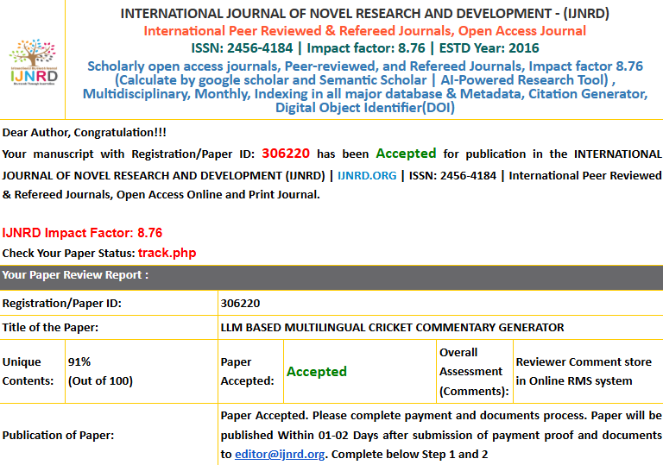
PROJECT OUTCOME

Slide 24
References
[1] Brown, T., Mann, B., Ryder, N., Subbiah, M., Kaplan, J., Dhariwal, P., ... & Amodei, D. (2020). Language models are few-shot learners. Advances in Neural Information Processing Systems, 33, 1877-1901.
[2] Xue, L., Constant, N., Roberts, A., Kale, M., Al-Rfou, R., Siddhant, A., ... & Raffel, C. (2021). mT5: A massively multilingual pre-trained text-to-text transformer. Proceedings of the 2021 Conference of the North American Chapter of the Association for Computational Linguistics: Human Language Technologies (NAACL-HLT), 483-498.
[3] Conneau, A., Khandelwal, K., Goyal, N., Chaudhary, V., Wenzek, G., Guzmán, F., ... & Stoyanov, V. (2020). Unsupervised cross-lingual representation learning at scale. Proceedings of the 2020 Conference on Empirical Methods in Natural Language Processing (EMNLP), 8440-8451.
[4] Devlin, J., Chang, M. W., Lee, K., & Toutanova, K. (2019). BERT: Pre-training of deep bidirectional transformers for language understanding. Proceedings of the 2019 Conference of the North American Chapter of the Association for Computational Linguistics (NAACL), 4171-4186.
[5] Fan, A., Bhosale, S., Schwenk, H., Ma, M., El-Kishky, A., Goyal, S., ... & Edunov, S. (2021). Beyond English-centric multilingual machine translation. Journal of Machine Translation, 35(1-2), 111-127.
[6] Gao, T., Fisch, A., & Chen, D. (2021). Making pre-trained language models better few-shot learners. Proceedings of the 59th Annual Meeting of the Association for Computational Linguistics (ACL), 3816-3830.
[7] Li, J., Sun, Y., Xia, Y., Li, X., & Bi, Y. (2022). Generating natural language commentary with pre-trained transformers. Artificial Intelligence Review, 55(5), 3785-3806.
[8] Lin, C. Y., & Och, F. J. (2004). Automatic evaluation of machine translation quality using longest common subsequence and skip-bigram statistics. Proceedings of the 42nd Annual Meeting of the Association for Computational Linguistics (ACL), 605-612.
[9] Liu, X., Lu, H., Qiu, X., Rao, Y., & Huang, J. (2021). Pre-training multilingual neural machine translation models with monolingual data. Proceedings of the 2021 Conference on Empirical Methods in Natural Language Processing (EMNLP), 4356-4371.
[10] Papineni, K., Roukos, S., Ward, T., & Zhu, W. J. (2002). BLEU: A method for automatic evaluation of machine translation. Proceedings of the 40th Annual Meeting of the Association for Computational Linguistics (ACL), 311-318.

Slide 25
References (contd.)
[11] Raffel, C., Shazeer, N., Roberts, A., Lee, K., Narang, S., Matena, M., ... & Liu, P. J. (2020). Exploring the limits of transfer learning with a unified text-to-text transformer. Journal of Machine Learning Research, 21(140), 1-67.
[12] Radford, A., Wu, J., Child, R., Luan, D., Amodei, D., & Sutskever, I. (2019). Language models are unsupervised multitask learners. OpenAI Blog, 1(8), 9.
[13] Vaswani, A., Shazeer, N., Parmar, N., Uszkoreit, J., Jones, L., Gomez, A. N., ... & Polosukhin, I. (2017). Attention is all you need. Advances in Neural Information Processing Systems, 30, 5998-6008.
[14] Wolf, T., Debut, L., Sanh, V., Chaumond, J., Delangue, C., Moi, A., ... & Rush, A. M. (2020). Transformers: State-of-the-art natural language processing. Proceedings of the 2020 Conference on Empirical Methods in Natural Language Processing: System Demonstrations (EMNLP), 38-45.
[15] Yang, Z., Dai, Z., Yang, Y., Carbonell, J., Salakhutdinov, R., & Le, Q. V. (2019). XLNet: Generalized autoregressive pretraining for language understanding. Advances in Neural Information Processing Systems, 32, 5754-5764.

Slide 26
THANK YOU

